Slide 1
BY A.NISHA REDDY 23AG1A0504 M.LAXMI NARAYANA 23AG1A0544
G.YASHWANTH 23AG1A0521
AGRI CONNECT
UNDER THE GUIDANCE OF MR V. CHANDRASEKHAR REDDY SIR

Slide 2
The Initial 3 ideas:
Yashwanth’s idea: Direct market access website for farmers.(AGRICONNECT).
Laxmi Narayana’s idea: AI based Energy breakdown to analyze energy consumption.
Nisha’s idea: A Digital Learning Platform.

Slide 3
Discussion with Guide
We discussed our idea and core functionalities with our project guide(Mr .V. Chandra Sekhar sir). His valuable inputs helped us refine AGRI CONNECT by:
✔ Enhancing AI-driven advisory for better accuracy
✔ Improving user accessibility with regional language support
✔ Strengthening marketplace features for direct farmer-to-buyer sales
His guidance played a key role in shaping our project into a more practical and impactful solution.

Slide 4
Which idea did we choose?
We have chosen the AGRICONNECT idea among the three ideas we had.

Slide 5
Abstract
Agri Connect is an AI-powered farming assistance platform that helps farmers overcome challenges. It provides real-time guidance in regional languages, an AI chatbot with Google Translate and speech-to-text, a community forum for knowledge sharing, and a marketplace for farm essentials

Slide 6
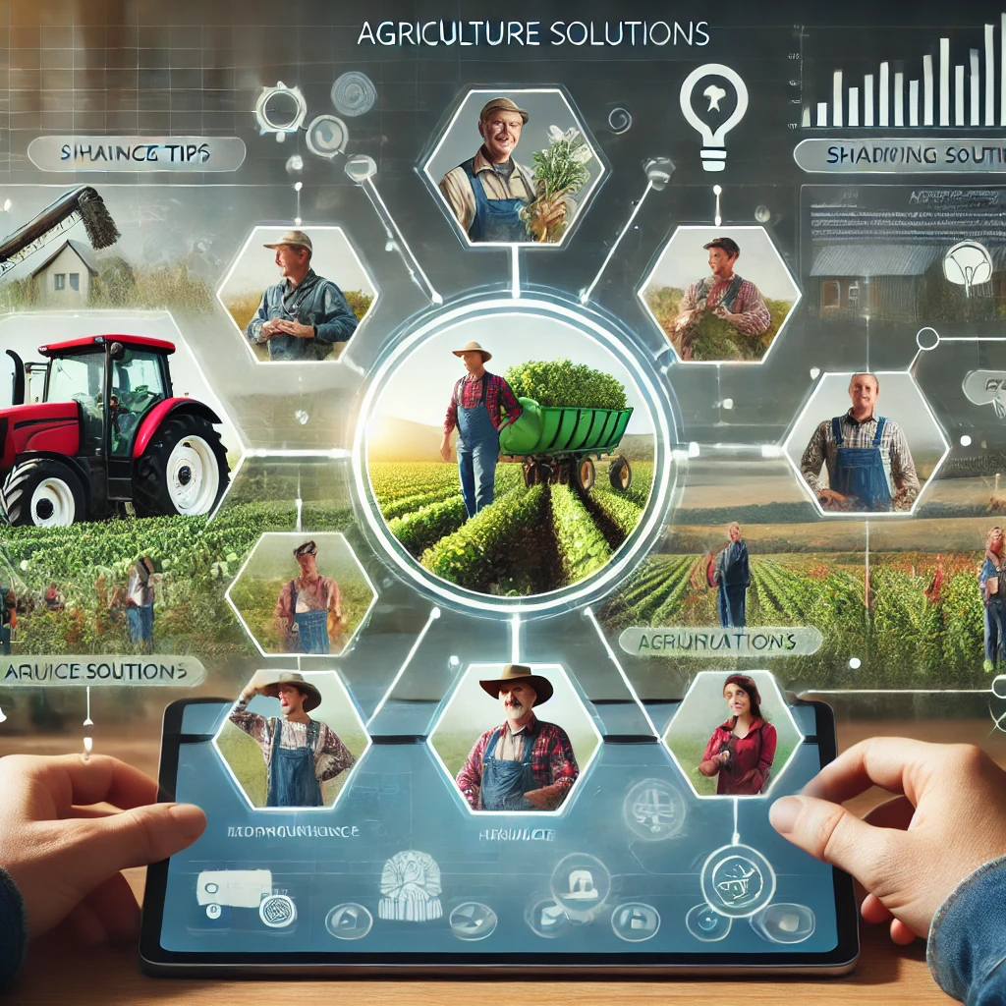
.
interaction for convenience.
INTRODUCTION
AI-Powered Assistance: Personalized farming tips and advice.
Community Forum: Farmers can share knowledge and ask questions.
Digital Marketplace: Easy access to farm supplies.
Localized Content: Available in regional languages.
Speech-to-Text: Voice-based interaction for convenience.

Slide 7
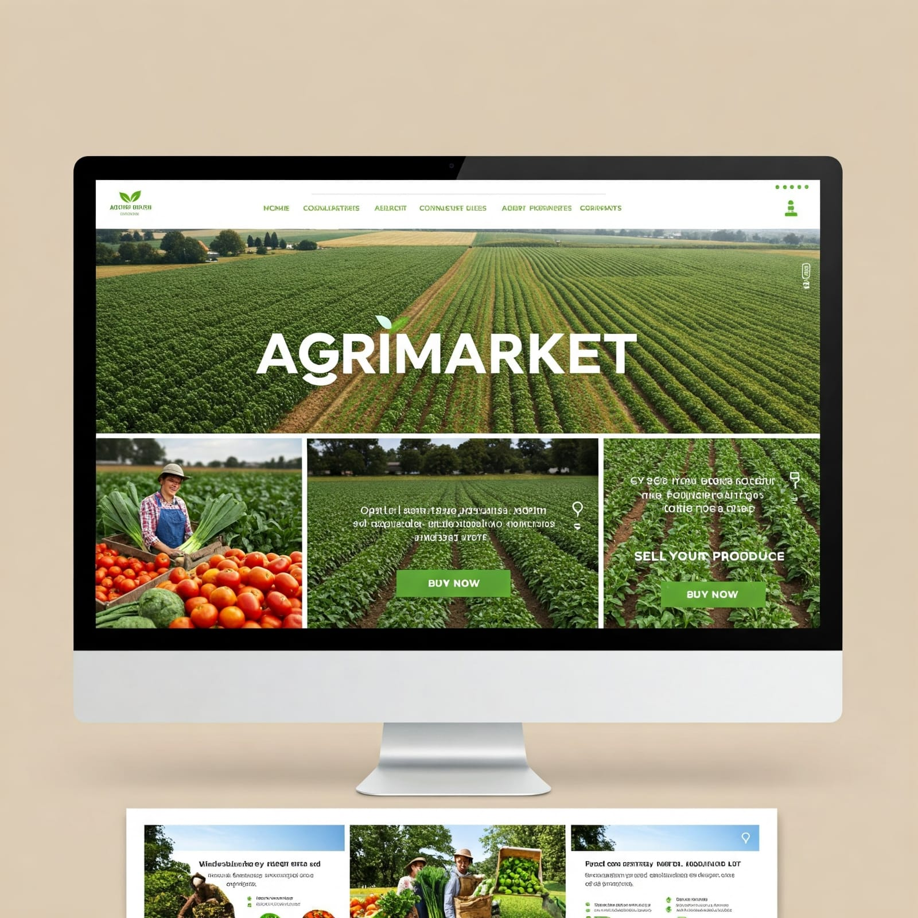
Existing System - 1
AgriMarket.
Drawbacks:
Lacks Real-Time Assistance: Does not provide instant, personalized farming guidance.
Low Interactivity: Limited community engagement or support features for farmers to connect.

Slide 8
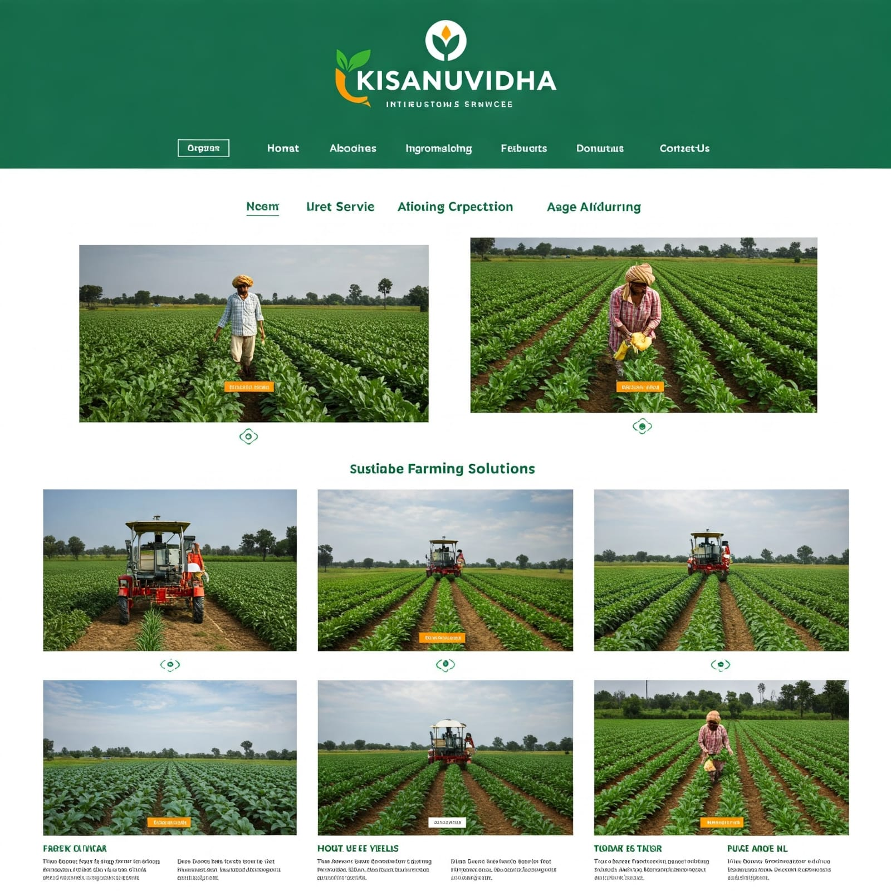
Existing System - 2
Limited Language Support: May not provide access to farming resources in all regional languages, limiting accessibility.
Incomplete Digital Marketplace: Does not offer a full range of farm essentials, tools, and resources in one platform.
KisanSuvidha.
Drawbacks:

Slide 9
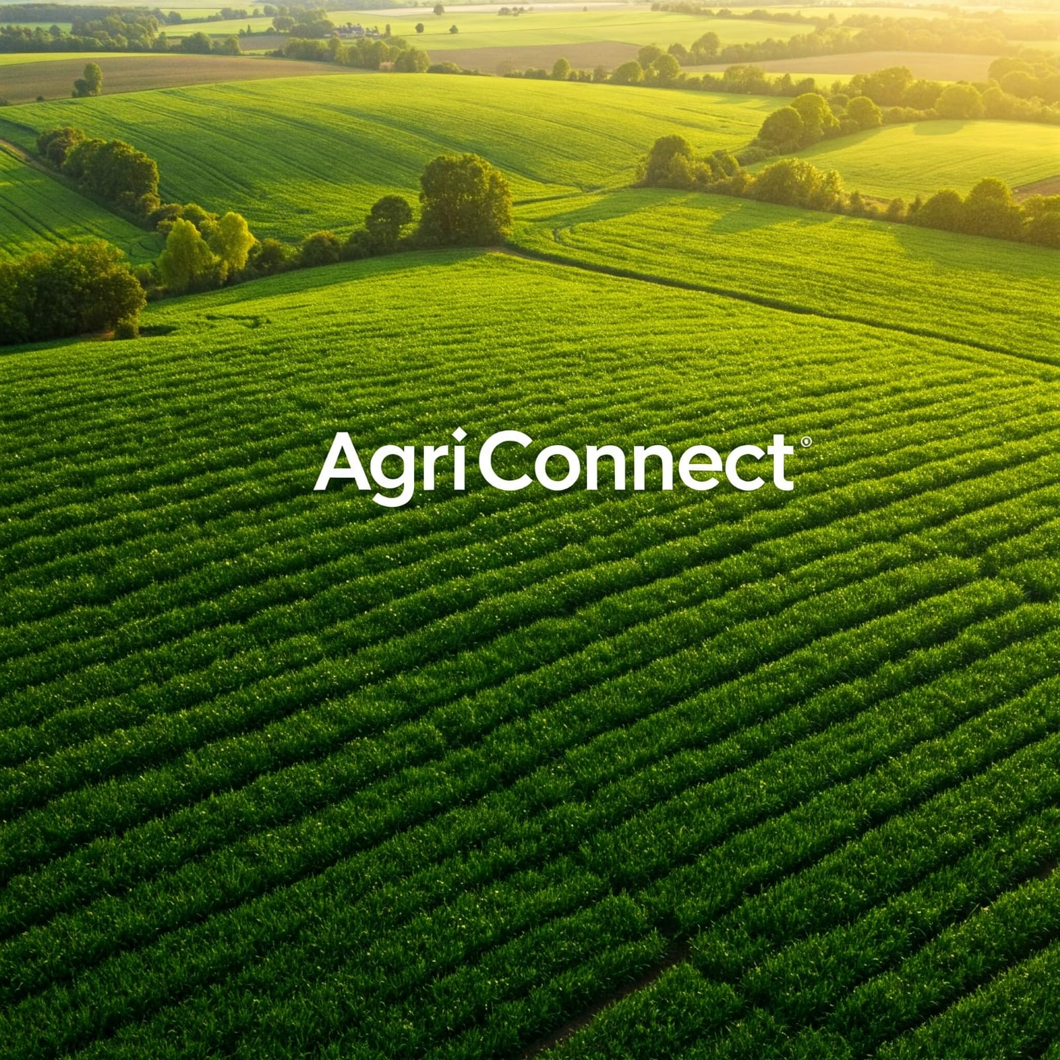
Proposed System
AgriConnect-A smart and farmer friendly platform
Key features:
AI-Powered Chatbot
Community Forum
Localized Digital Marketplace
Farm Tracking Dashboard

Slide 10
Why we chose this idea?
AgriConnect empowers farmers with real-time guidance, language support, community collaboration, and digital tools for better farming efficiency.
Addresses Real Agricultural Challenges.
More Accessible Than Traditional Apps.
Supports Regional Languages.
Encourages Farmer-to-Farmer Learning.

Slide 11
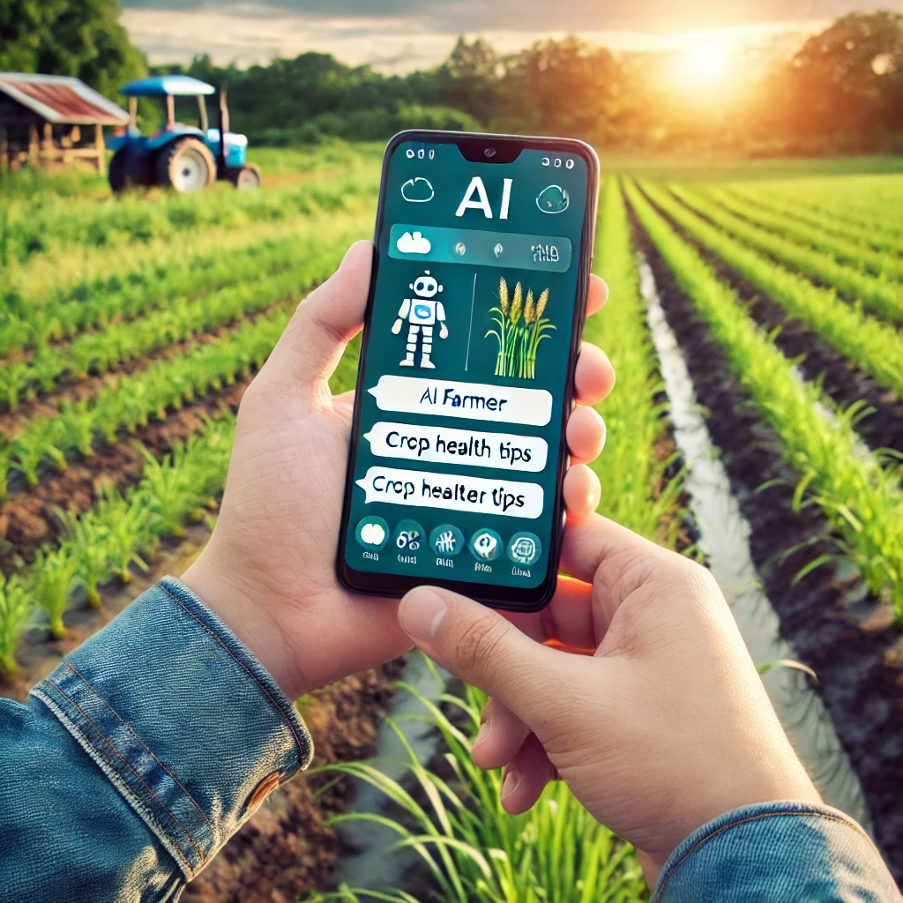
Tools and methods
Technology Stack:
Frontend: HTML, CSS, JavaScript, React.js
Backend: Node.js, Express.js
Database: SQL
APIs: Google Translate API for multilingual support

Slide 12
Software Requirements
Frontend - HTML, CSS, JavaScript
Backend - Node.js, Express.js
Database - Firebase / MongoDB✓
AI & NLP - Google Dialogflow & Translate
Live Data Open Weather & AgriMarket APIs✔
Dev Tools - VS Code, Postman, GitHub✔
Hosting - Vercel (Frontend), Firebase/Render (Backend)

Slide 13
Hardware Requirements
For Development: Laptop (8GB RAM, 15+), High-Speed Internet, Mic & Speakers
For Hosting: Cloud Server (Firebase, Vercel, Render), Reliable Internet✔
For Farmers: Smartphone/PC, Stable Internet for Al & Marketplace

Slide 14
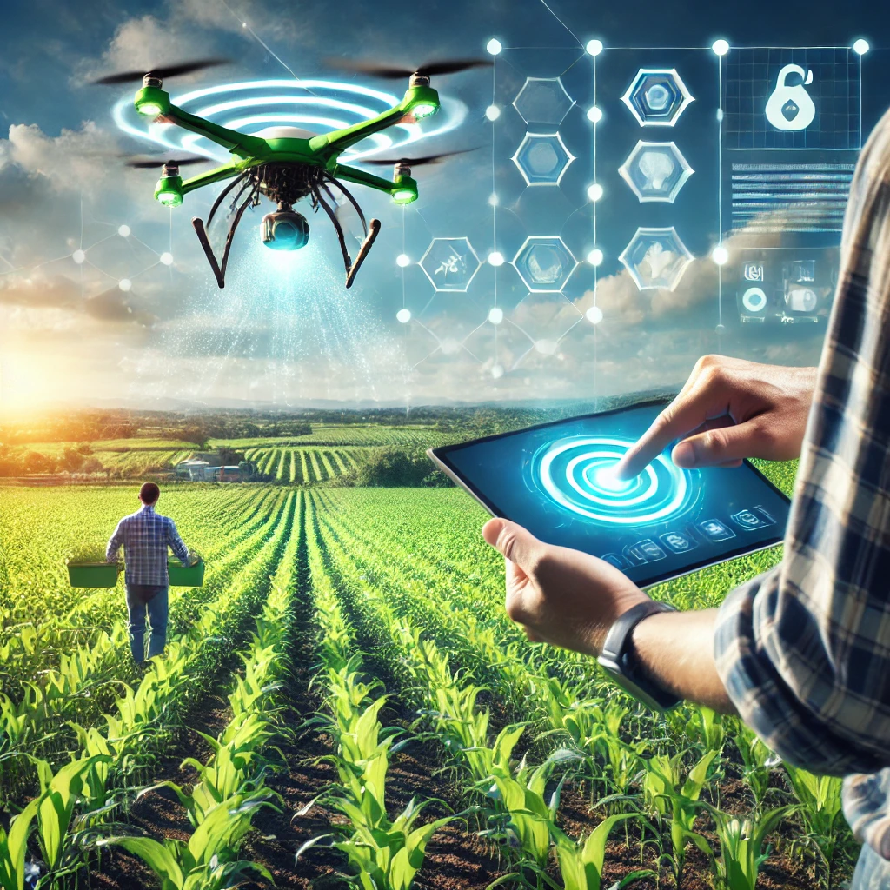
Conclusion
Smart AgriConnect empowers farmers with real-time guidance, language support, community collaboration, and digital tools for better farming efficiency.

Slide 15
THANK YOU

